Slide 1
Hiram Elementary 2nd Grade Virtual Academy
Ms. CaÑate, Ms. Henderson & Mrs. mcmahan

Slide 2
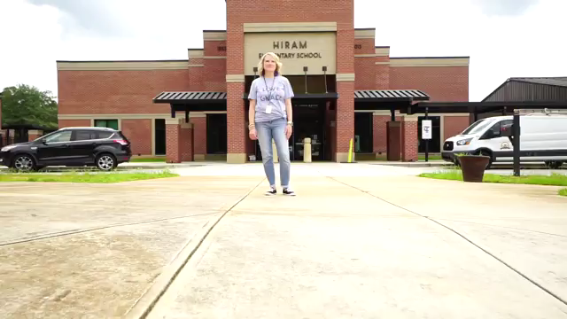
Open House Video

Slide 3
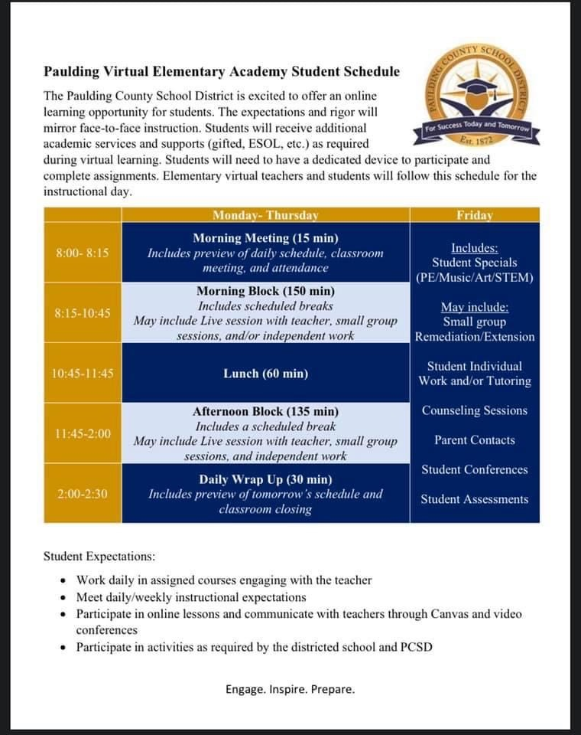
Daily Schedule
This is the county’s suggested schedule for the virtual academy.
Morning meeting will begin between 8:00 and 8:05.
Students should be prepared before 8:00 to make sure their devices work.
Morning block will be a combination of live/recorded teaching and work time. This will be our reading and language arts block.
Lunch time is a free time for students for student to eat and have recess. Lunch will begin at 10:40 instead of 10:45.
Afternoon block will consist of math live/recorded teaching and work time.
There will be an afternoon wrap up meeting at 2:30 each day. The length of this will vary daily. This will be a great time for students to ask questions.
8:00-8:15
8:15-10:40
10:40-11:55
11:55-2:00
2:00-2:30

Slide 4
Friday Schedule
Students will complete lessons for their Specials classes. (PE, Art, Music, STEM). There will be Friday assignments for all four specials classes.
Qualifying students for ESEP, ESOL, Title I, Venture and EIP services will receive small group instructions. Students that get these services may meet with these resource teachers multiple times during the week.
Virtual homeroom teachers will hold small group live/recorded sessions for lesson extension and/or remediation as needed.
Virtual teachers will make any necessary parent contacts.
Students may be taking assessments.

Slide 5
The Difference…Digital vs. Virtual
Virtual Learning includes live teaching via live teaching sessions and student work time. Virtual lessons will mirror face to face instruction that is being delivered in the classrooms at Hiram Elementary.
Live teaching sessions may be whole group and/or small group. Students need to know how to log into Canvas.
At times student will participate in Digital Learning Days. Digital Learning Days consist of assignments that are preloaded into Canvas. Students will complete these assignments on their own with no live teaching sessions.
Students must be present for Virtual Learning from 8:00-2:30 daily. Digital Learning assignments can be completed at any time each day.
You will be notified of Digital Learning Days.

Slide 6
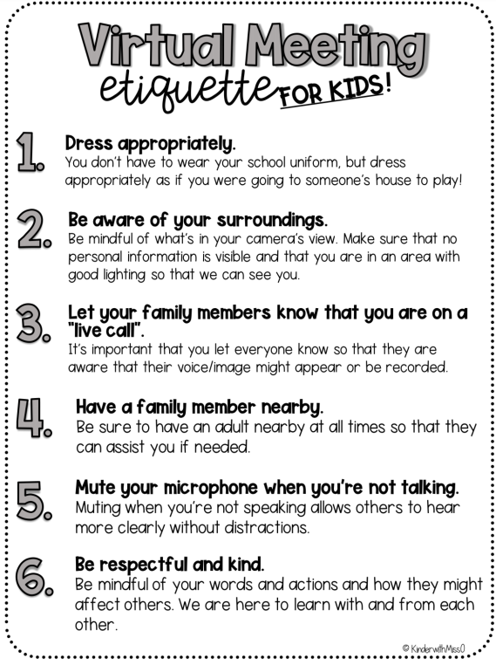
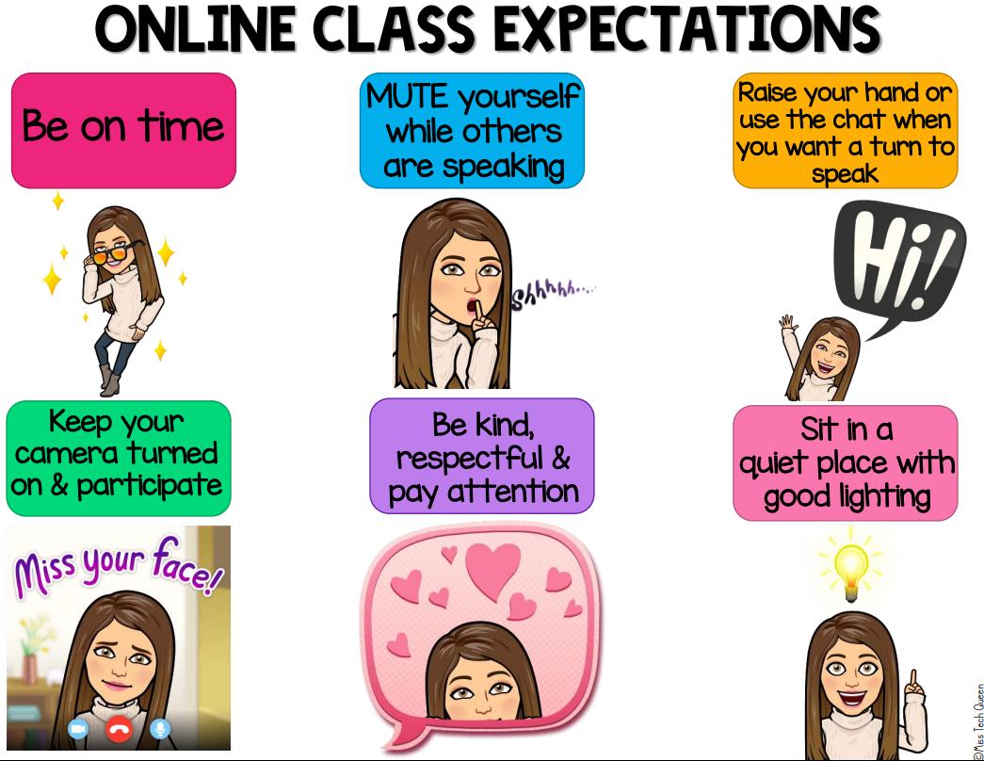
Student Responsibilities and Rules

Slide 7
Student Expectations
Students are expected to attend class everyday. Attendance will be taken every day.
Students should be attentive, engaged and on task during lessons.
Students should stay on topic and not have discussions with other students that do not pertain to the lesson. This includes conversations in the chat feature.
Students should complete their own work.
Students should use appropriate language when asking questions.
Students should refrain from eating during live teaching sessions.
Students should be respectful, responsible and ready to succeed.

Slide 8
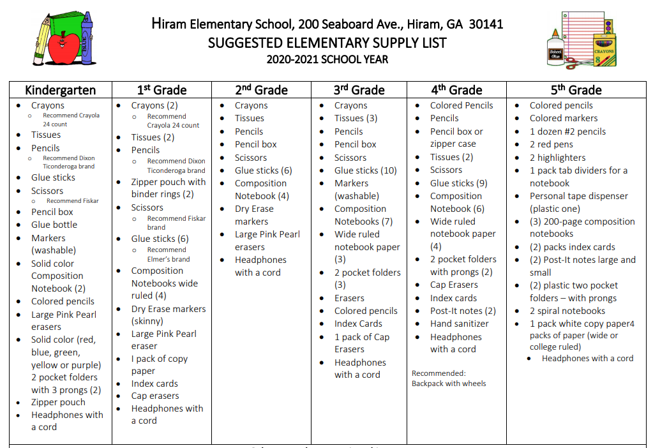
Student Supplies
Virtual students are required to have all school supplies.
A device such as a tablet or smart phone may be needed for submitting assignments in Canvas.
Dry erase markers are not needed for virtual students.
Additional suggested supplies:
  Construction or drawing paper

Slide 9
Class Dojo
Class Dojo will be used to monitor student behavior.
Students will be given positive and negative points for behavior.
Parents will be sent a code to join Class Dojo via email or text message.
The purpose of Dojo Points is to inform parents of student behavior during live teaching sessions.
Class Dojo may also be used as a communication tool.

Slide 10
Parent Information
Weekly newsletters will be posted to Canvas.
Any necessary payments will be made through RevTrak.
Parents may contact teachers via Class Dojo, email or Canvas.
Parents will need a Parent Portal account. Student grades will be posted digitally only. To register for Parent Portal email portal@paulding.k12.ga.us
Please fill out the Parent Information Form and send it back to your child’s teacher as soon as possible. This can be found under the Open House Module in Canvas.

Slide 11
Teacher Contact Information
Laura Cañate: lcanate@paulding.k12.ga.us
Kim Henderson: khenderson@paulding.k12.ga.us
Brandi McMahan: bmcmahan@paulding.k12.ga.us
Teachers can be contacted through the message feature on Class Dojo.
Hiram Elementary: (770)443-3392

